Slide 1
Data Analytics for Monitoring & Evaluation of Government Schemes
A Case Study on Puducherry Welfare Schemes with Predictive & Preventive Insights
Presented by: Thamizhvaanan I
Application No: SSMDA2024-10687

Slide 2
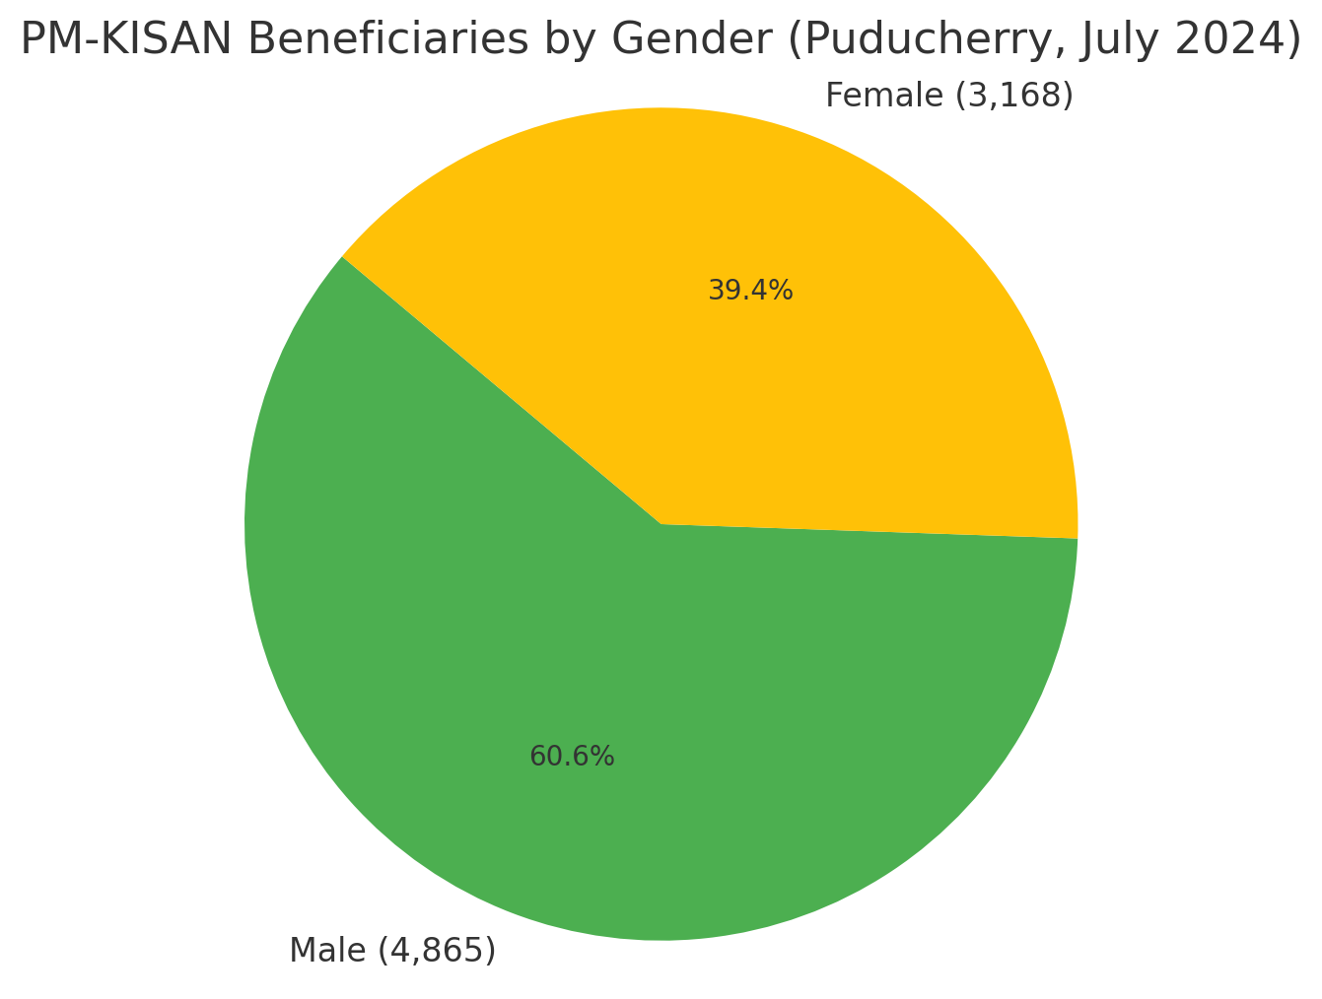
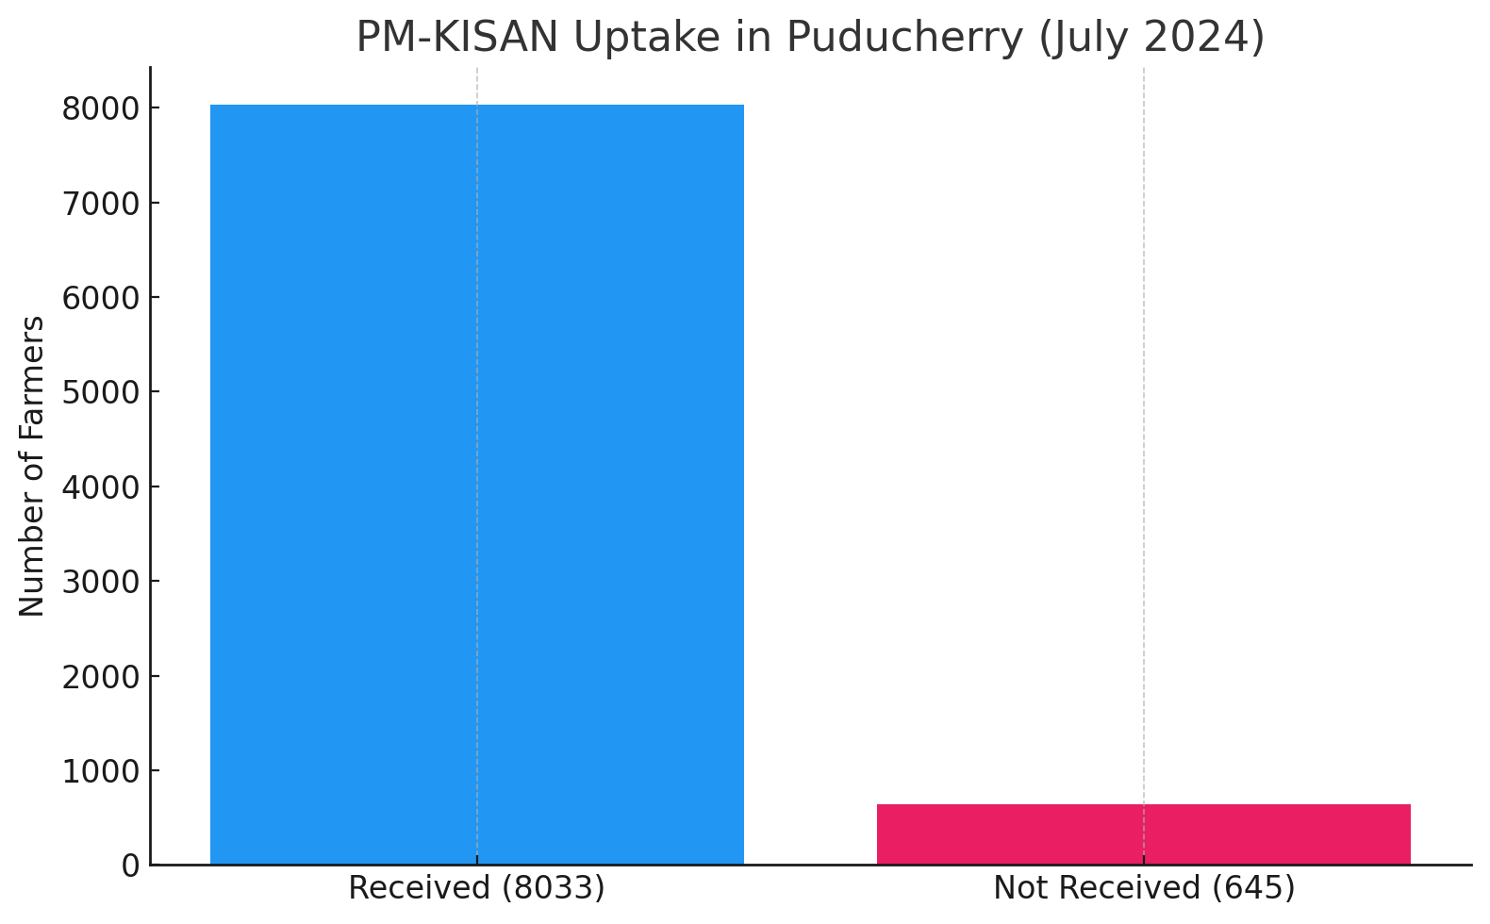
Monitoring Beneficiary Trends – PM-KISAN DBT Scheme
Scheme: PM-KISAN – Direct Benefit Transfer of ₹6,000/year to farmers
Total Registered Farmers: 8,678
Beneficiaries Receiving DBT: 8,033
Women Beneficiaries: 3,168
Farmers Not Receiving Payments: 645
Insight:
- 645 eligible farmers have not received payments despite
being registered
- Monitoring gap of 7.43% in last-mile DBT delivery
Location: Puducherry Source: https://pmkisan.gov.in Year: 2024 Aug–Nov installment cycle

Slide 3
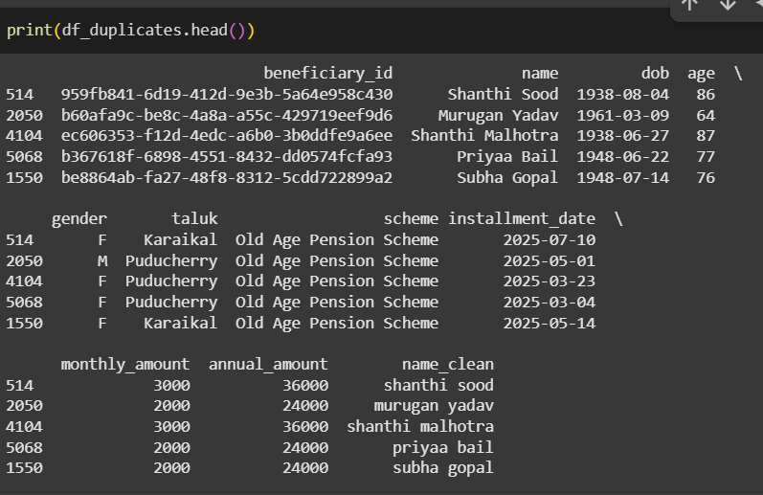
Anomaly Detection in Old Age Pension Scheme Disbursement
Scheme: Puducherry Old Age Pension Eligibility: Citizens aged 55+ Monthly Payout: ₹1,500 – ₹3,000
Dataset: Simulated 5,000+ entries based on
real beneficiary patterns
Duplicate Detection:
- Python used for fuzzy matching (Name + DOB + Taluk)
- 108 flagged as potential duplicate beneficiaries
Estimated Leakage Risk:
- Total Annual Amount at Risk: ₹53.16 Lakhs
Sample of flagged duplicate entries using fuzzy matching
Similar Real-World Cases:
Delhi SCAM (2023): 3,000+ duplicate pensioners
Assam Widow Scheme Fraud (2022): Aadhaar-linked duplications
Tools Used: Python (Pandas, FuzzyWuzzy), Excel

Slide 4
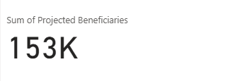
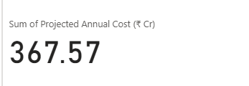
Forecasting Demand – Old Age Pension Scheme (2025–2030)
Scheme: Puducherry Old Age Pension Forecast Period: 2025 – 2030
Method: Linear forecast based on historical trends & population growth
Beneficiary Growth:
- 2025: 1.2 lakh
- 2030: 1.53 lakh (projected)
Annual Growth Rate: ~5% in both beneficiaries & cost
Insight: Budget planning must consider aging population
Financial Forecast:
- 2025: ₹290 Cr
- 2030: ₹367.57 Cr
Data Sources
- Census 2011 + Projected 2021/2024 population data
- NSSO + Population Foundation of India reports

Slide 5
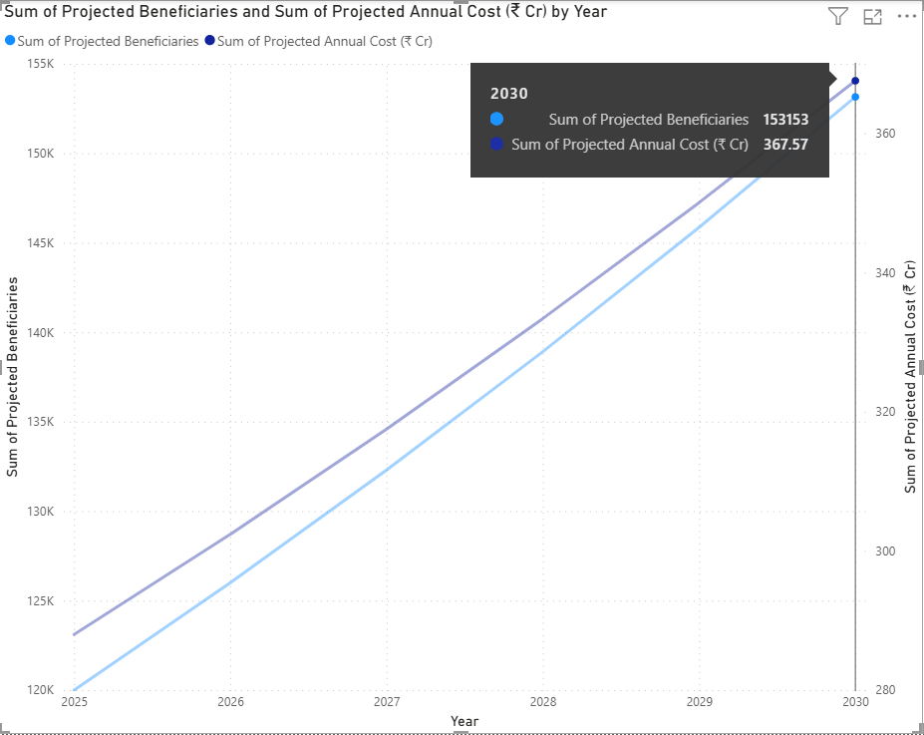
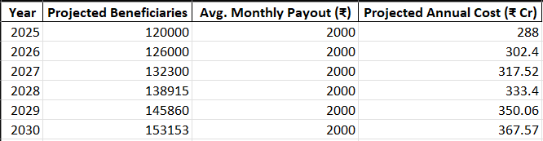
Senior Citizens in Puducherry:
- 2024 Estimated Population: 16 lakhs
- 9.7% aged 60+: 1.55 lakh seniors
- Assume 80% coverage: 1.2 lakh beneficiaries in 2025
Growth Assumptions:
- Annual Growth Rate: 5% (conservative)
- Formula: Future = Present × (1 + rate)^years
Projected Rise in Beneficiaries & Cost (2025–2030)
Tools Used: Python (forecasting logic), Power BI (visualization)

Slide 6
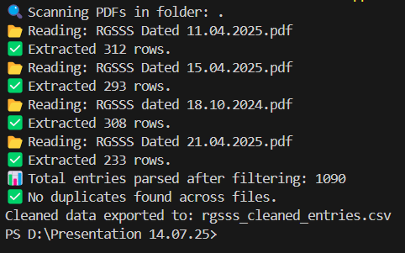
Real-World RGSSS Data Validation
To provide financial assistance to BPL individuals aged 18–60 in Puducherry in case of death or disability due to natural or accidental causes.
What I Did
Collected & parsed 4 official RGSSS PDF orders.
Cleaned and standardized claimant names & addresses.
How I Validated
Removed prefixes (S/o, W/o, D/o).
Applied fuzzy matching logic:
Name ≥ 90%, Address ≥ 85%
Checked across all 4 PDFs for duplicate beneficiaries.
Outcome
Parsed 1090 real entries.
No duplicates found — official data appears clean
and consistent.

Slide 7
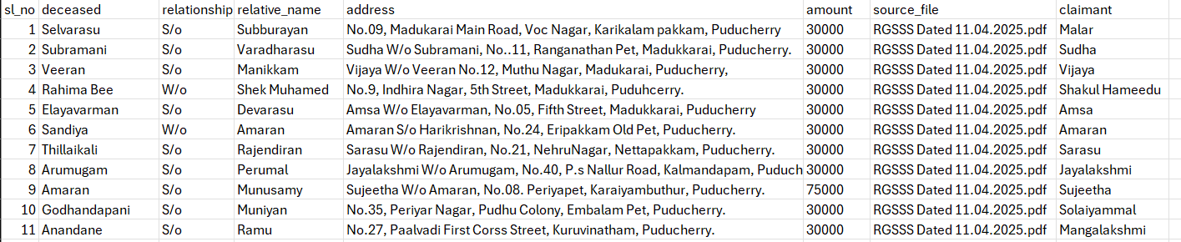
CSV Export: Cleaned Dataset
To prove the data was actually processed and cleaned, I exported the final entries into a structured CSV file.
Each row includes:
Deceased person
Relationship
Relative Name
Cleaned address
Extracted amount (₹)
Source file
Claimant name (cleaned & normalized)
Source files:
RGSSS dated 18.10.2024.pdf RGSSS Dated 15.04.2025.pdf
RGSSS Dated 11.04.2025.pdf RGSSS Dated 21.04.2025.pdf
Total: 1090 validated entries
Ready for further analysis, audit, or visualization.

Slide 8
Summary & The Power of Data Analytics in Governance
PM-Kisan DBT: Gender & Payment Monitoring
- Identified 7.43% of farmers not receiving benefits - Found 39.4% women participation — key equity metric
Duplicate Detection in Pension Scheme
- Flagged 108 potential duplicates using Python & fuzzy matching
- Estimated leakage: ₹53.16 Lakhs/year - Inspired by real scams in Delhi & Assam
Forecasting Future Scheme Demand
- Used Census + growth logic to project costs till 2030
- Found demand will grow by 27% in 5 years - Predicted ₹367 Cr required by 2030
Real-World RGSSS Audit
- Parsed 1090 entries from 4 official RGSSS PDF orders (Oct 2024 – Apr 2025)
- Cleaned and standardized claimant names & separated amount from address
- Applied fuzzy matching to detect duplicates across files (Name ≥ 90%, Address ≥ 85%)
- Found no anomalies — official data appears clean and consistent

Slide 9
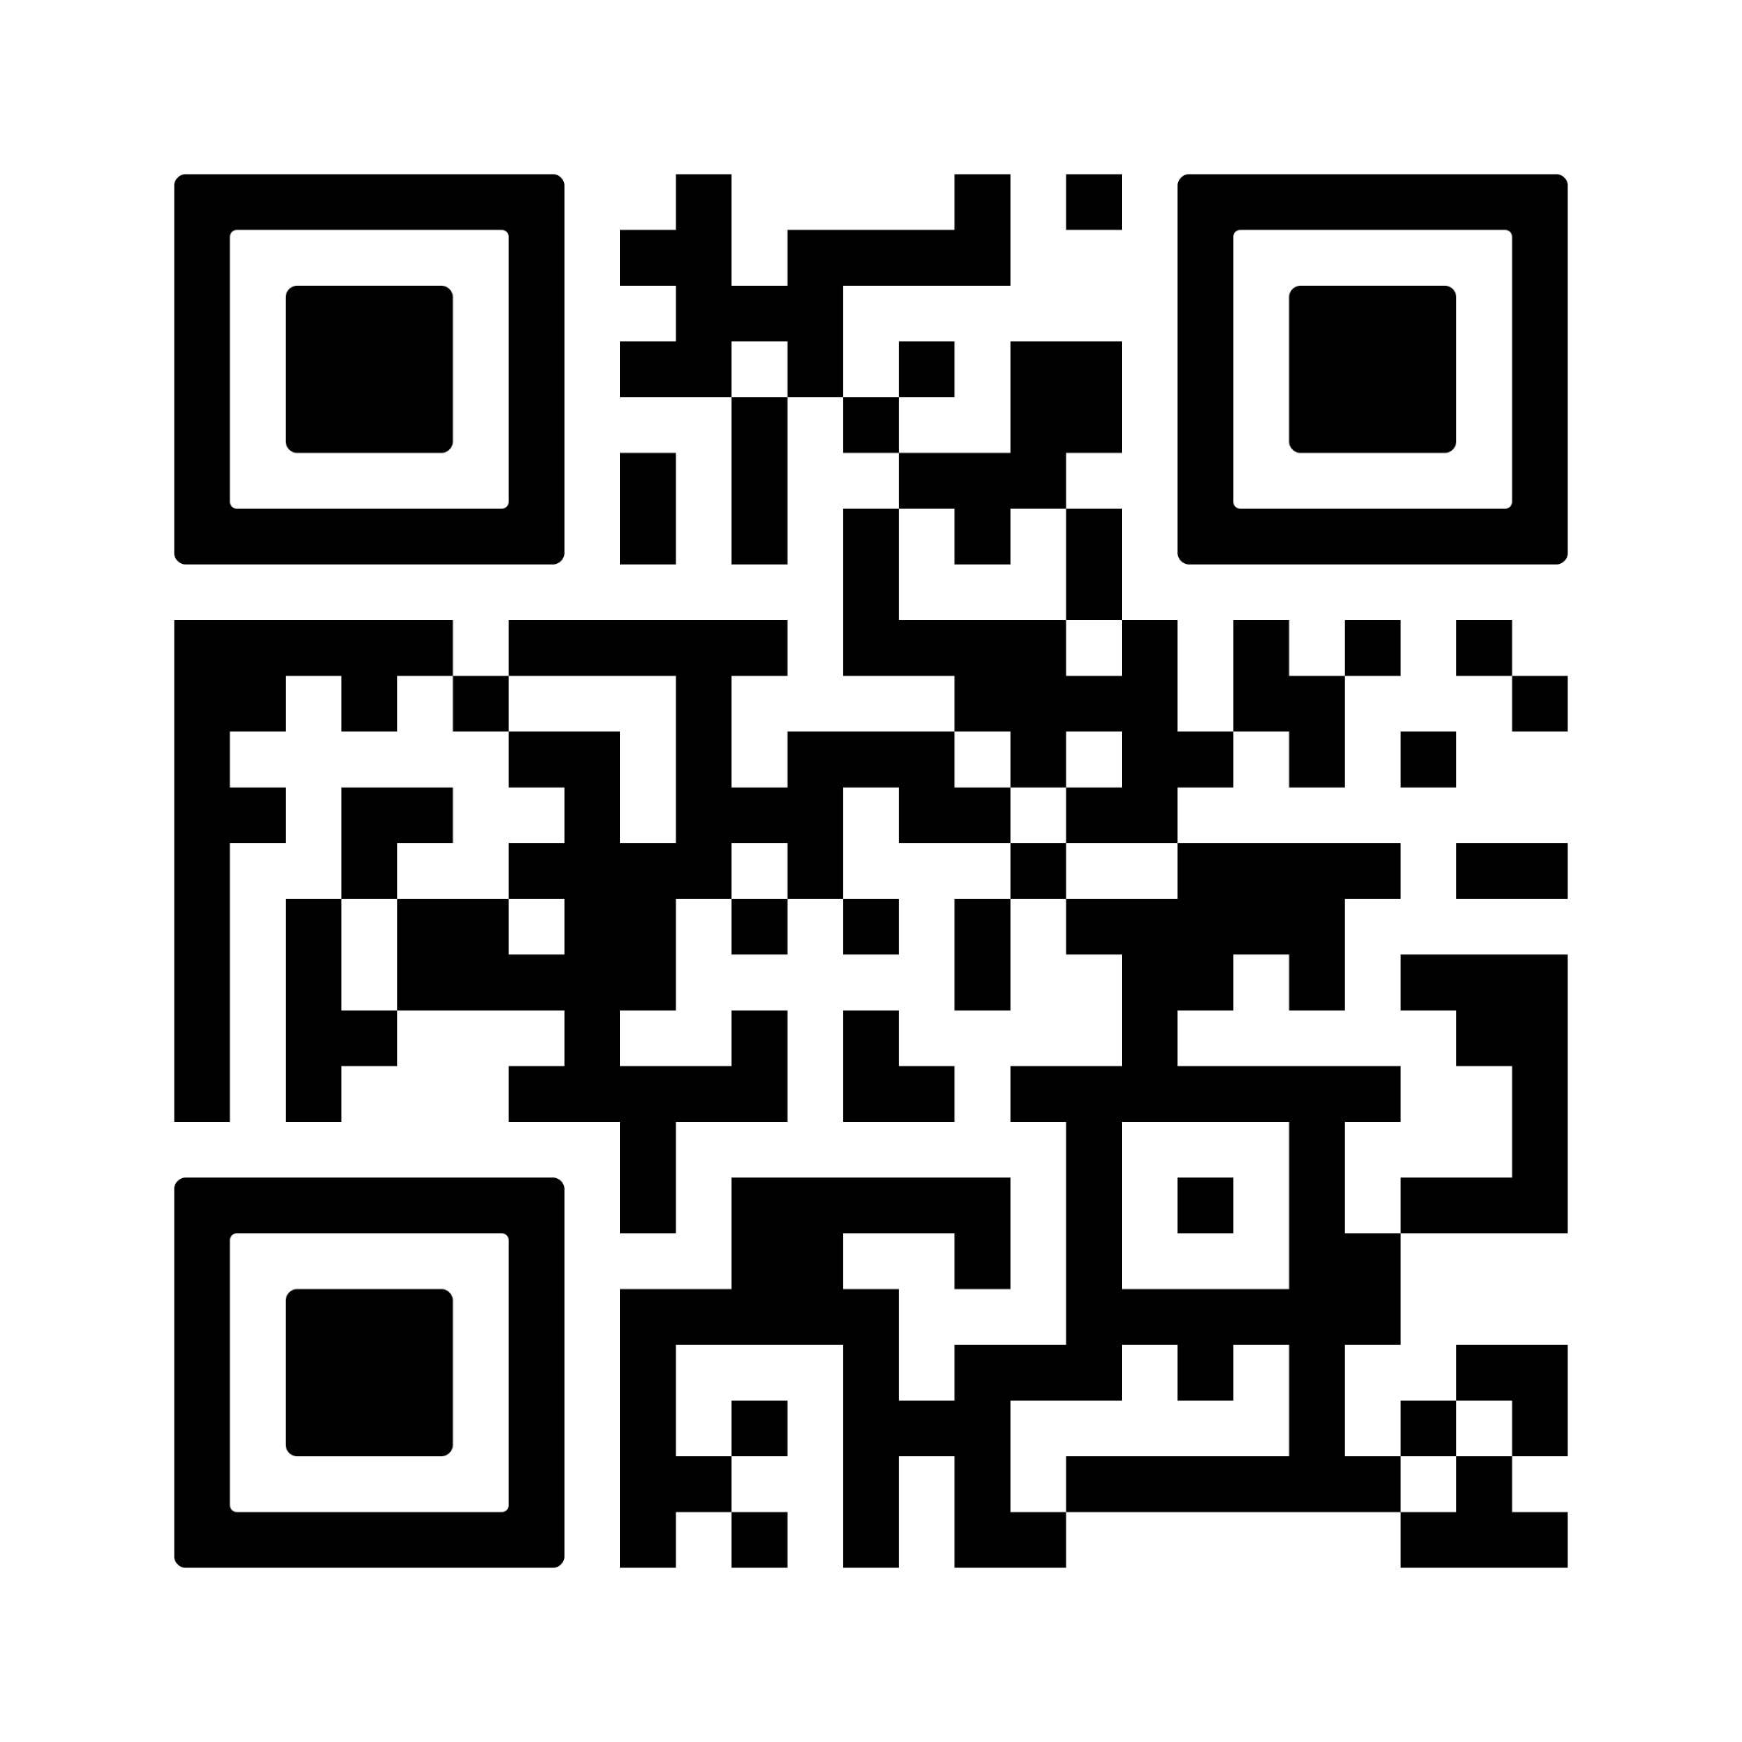
Thank you!
Thank You for the Opportunity
I hope this presentation showed how data analytics
can make public welfare schemes more effective, fair, and future-ready.
I’m ready to contribute to Puducherry’s transformation
with practical, actionable, and scalable data-driven solutions.
Thamizhvaanan I
SSMDA2024-10687
thamizhvaananilango.com

